Slide 1
PENTRAN-CRT Code Workshop
AFIT
October 2015

Slide 2
Overview
Code Overview – G. Sjoden
Features, Adaptive Differencing, Parallel Issues
Code Examples and Applications –
Large problems, Hybrid Methods, etc
Parallel Performance
Problem examples
Parallel Scripts, PENDATA gathering
Output Details and analysis tools
PENMSH-XP
Problem and Mesh Generation Tools
PENMSH-XP GUI
Exercises and Exploration
2
Notes:
PENTRAN CODE SYSTEM
2

Slide 3
PENTRAN Code Overview
Presented by
Glenn E. Sjoden, Ph.D., P.E.

Slide 4
PENTRAN Code
To be available Free to Universities and USG entities
US Citizens and US Residents
PENTRAN runs on ALL types of distributed parallel computers
Parallel decomposition in Angle, Energy, and Space
ANSI F90 standard code
Tested on up to 4096 Cores with excellent scaling
Has undergone significant benchmarking
Is under continuous enhancement
Is being established as a tool at AFTAC for 3-D radiation transport applications
4
Notes:
PENTRAN CODE SYSTEM
4

Slide 5
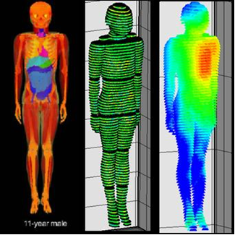
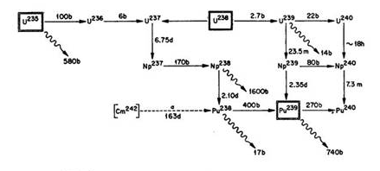
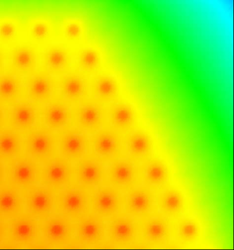
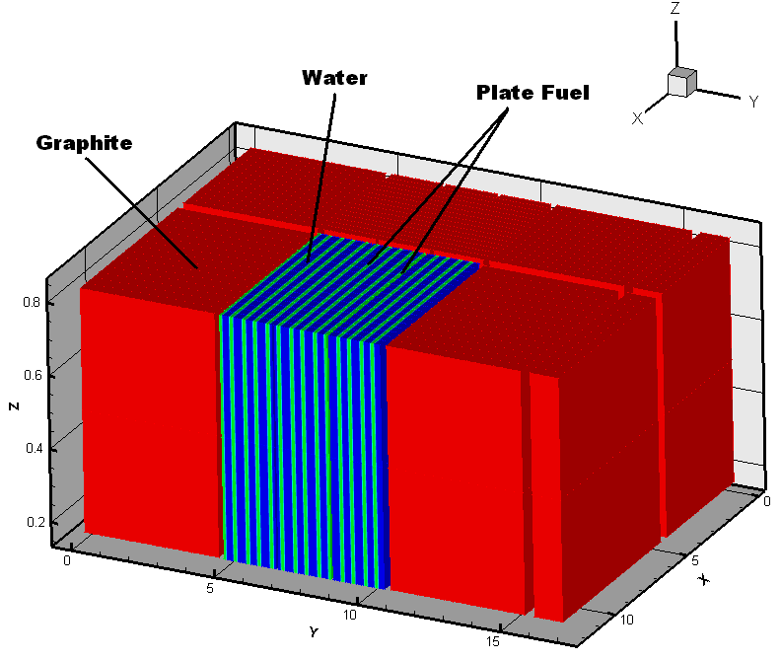
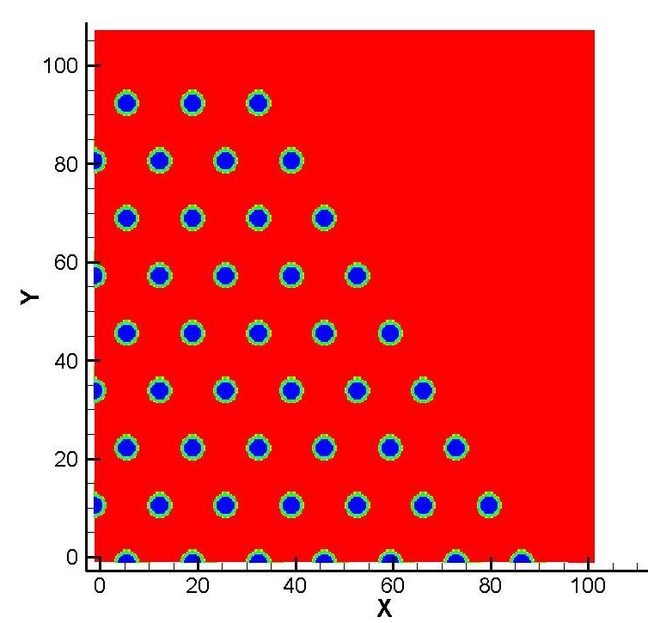
PENTRAN Parallel Code System
PENMSHxp -- “PENMSH eXPress” by C. Yi and A. Haghighat
Automatic mesh and code deck generation
“PENTRAN-CRT” Code with adaptive Sn and Characteistic Ray Trace Hybrid
Now Undergoing testing and benchmarking with TITAN code
“PENTRAN-MP” Code Set for Whole Body Medical Physics Applications
Under further development and testing with Electron Dose Kernel (EDK) Methodology
“PENBURN” Burnup Module for 3-D burnup/parallel chain processing
Used for new methods in detection, characterization, reactor analysis
Scalable memory & processing enables ‘extreme’ transport to >10⁹ unknowns
5
Notes:
PENTRAN CODE SYSTEM
5

Slide 6
PENTRAN Overview
Parallel Computing & MPI
Boltzmann & Sn Transport
PENTRANTM Code System
Features
Adaptive Differencing, Parallel
Discussion and Summary
Questions

Slide 7
What is Parallel Computing?
Computer with many processors
“Lumped” or Network “Distributed”
Divide problem up on processors
Serial...
Task1
Task2
Task3
RESULT
Parallel…
Task1 Task2 Task3
RESULT

Slide 8
About MPI...
MPI (Message Passing Interface) Library
Began with “MPI Vendor Forum” May 1994
Formalized in 1995
For distributed memory machines (FORTRAN, C, other language variants support)
ANSI-like “standard” in message passing
Process com groups, decomposition topologies
Port code directly to architectures running MPI
Versions: MPICH, MPICH2, OPENMPI

Slide 9
About MPI… (2)
A Minimum Set of MPI Calls (Fortran or C):

Slide 10
Parallel Job Setup/Compile
Normal FORTRAN or C programming
MPI libraries are included in each routine requiring them:
INCLUDE 'mpif.h’, include ‘mpi.h’
Same code executed on each processor
Logical coding controls "who does what"
User responsible for:
start/stop/all synchronization
message passing calls/memory management

Slide 11
Amdahl’s Law: Speedup is Limited
(Parallel Code Fraction = f )
Sp = 1 / ((1-f) + f/p + T_{c} /T_{s})
Speedup= Sp = T_{s} / T_{p,} Efficiency= E = Sp / P
If f =0.8, then max Sp =5.0 as P->Infinity

Slide 12
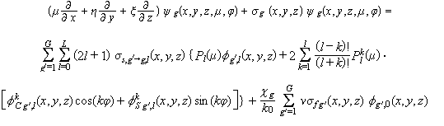
3-D Boltzmann Equation
Boltzmann Transport Equation
Track particles traveling in different …
directions
over a range of energies
in different spatial locations in 3-D

Slide 13
Transport Theory
Boltzmann transport methods
Monte Carlo method
Discrete Ordinates (S_{N} ) method
Each has specific … Advantages (+) Disadvantages (-) Issues
Both methods can take advantage of
parallel processing!

Slide 14
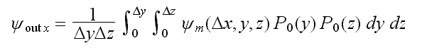
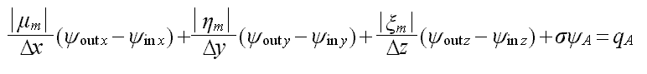
3-D Discrete Ordinates (Sn)
Balance Equation… “out” “in”
Surface Averaged Fluxes

Slide 15
Monte Carlo
Advantages
Traditional, straight forward
Geometrically precise
Robust particle physics--Continuous-Energy xsec
Parallelization obvious: particle histories
Disadvantages:
Processing time, Non-analog variance reduction
Inevitable uncertainties and Central LT
“Global” solution difficult to obtain
Results can be limited in application

Slide 16
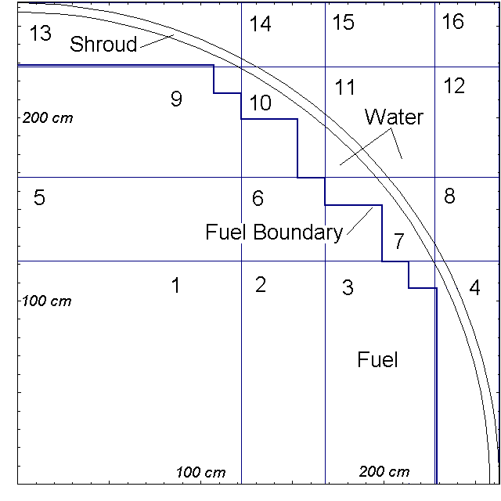
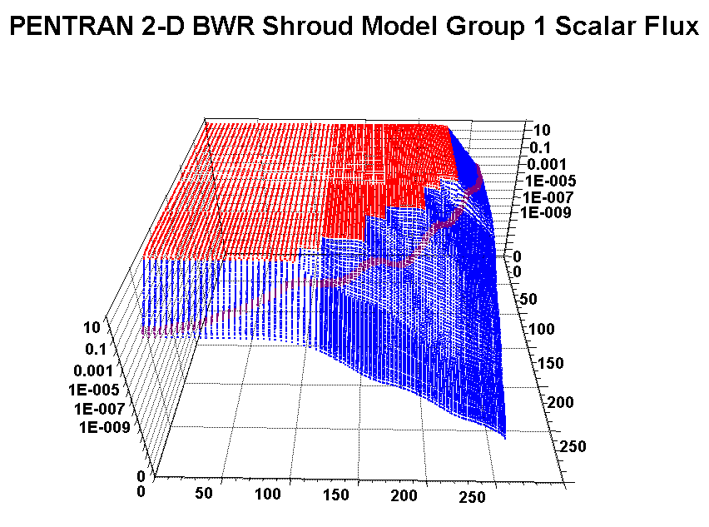
Discrete Ordinates
Advantages
Model entire geometry
Fast and accurate
Global flux distribution
Directly allows for burnup, etc
Disadvantages:
Proper multi-group cross sections
Geometry discretized
Memory, storage, differencing scheme issues
Parallelization--coupling in angle, energy, space

Slide 17
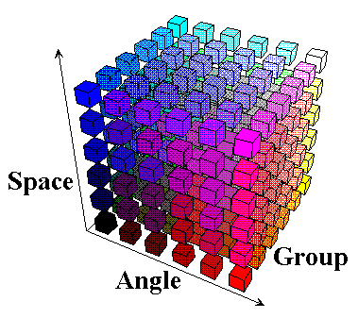
PENTRAN Code System
Parallel Environment Neutral-particle TRANsport
Two decades of continuous development
Introduced in 1996 by Sjoden and Haghighat
Parallel S_{N} in angle, energy, and space & I/O
ANSI FORTRAN 90, ~40k lines
Industry standard FIDO input
Solves 3-D Cartesian Sn Equations
Multigroup, anisotropic transport problems
Forward and adjoint mode
Fixed source
Criticality eigenvalue problems

Slide 18
Distributed Memory Programming Philosophy PENTRAN
Programming Model:
View message passing as a last resort
Minimize serialization, minimize barriers
Use a partitioned memory storage of data
Only way to solve larger problems
Process mapping arrays to determine “who’s where”
Overall...
Use of a coarse-grained code structure
Many flops performed before messages passed
Don’t forget about Amdahl’s Law

Slide 19
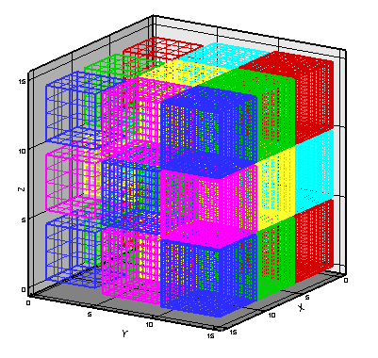
Coarse Mesh/Fine Mesh Scheme
Primary Two level meshing scheme for
Cartesian geometry
Model divided into coarse meshes (CMs)
Each CM filled with fine mesh grids
“Block adaptive” fine mesh structure,
No requirements on surrounding CMs; Higher order coupling with TPMC
Intermediate mesh level (“medium” grids ) for “/-multigrid” nested iteration
3 x 3 x 3 coarse mesh Model

Slide 20
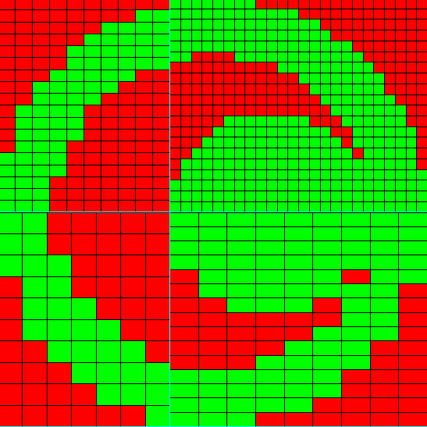
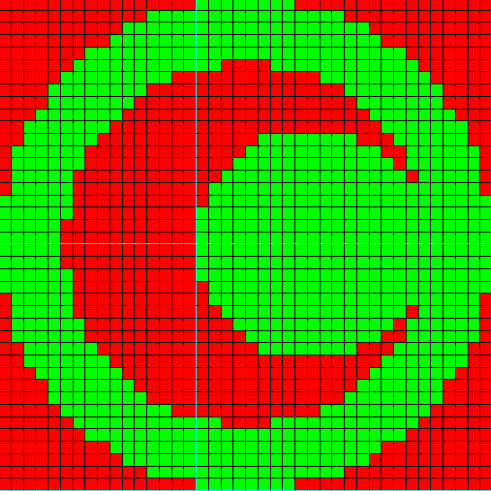
Block Adaptive Mesh Generation
PENMESH-XP- automatically sets up problem
You define shapes, 3-D intervals, it does the rest…
Coarse Mesh Structure
Fully discontinuous variable meshing among coarse meshes

Slide 21
PENMSH-XP input: “Z-level” basis
File names | Description | PENMSH XP
penmsh.inp | Meshing parameters | Required
prbname#.inp | Meshing per ‘z level’ | Required
prbname.src | Fixed source grid | Optional
prbname.spc | Source spectrum | Optional
prbname.chi | Fission spectrum | Optional
prbname.mba | Material balance | Optional
prbname#.flx or prb#.flx or .fjn files | Group fluxes (.flx) or current (.fjn) generated by PENDATA from PENTRAN calculation | Optional

Slide 22
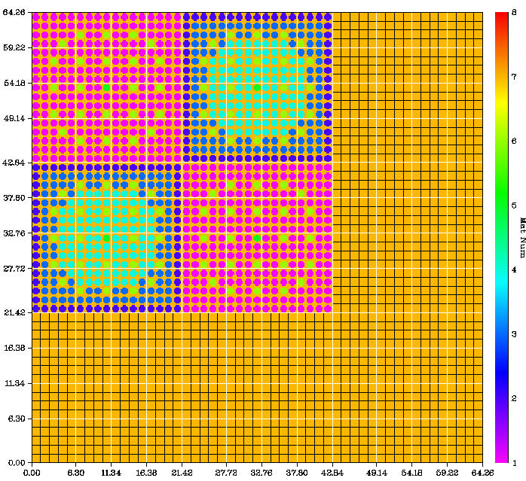
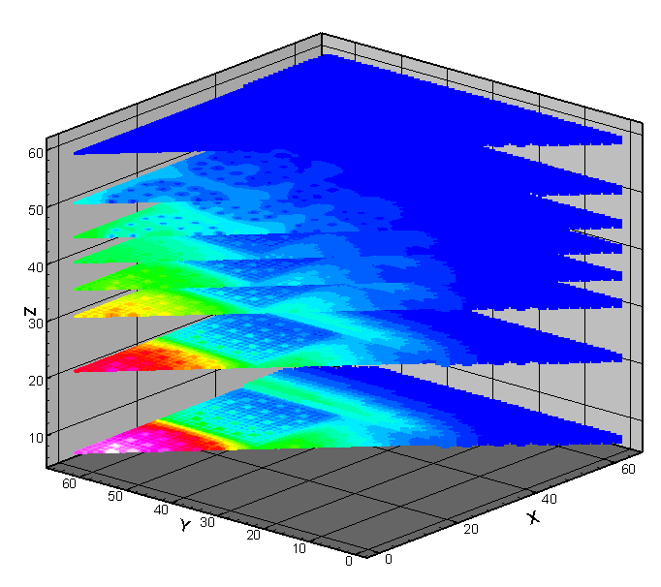
Sample Geometry Slice from PENMSH-XP
2-D Geometry, Flux Plots, nuclear reactor model

Slide 23
PENTRAN
Parallel Implementation
Uses MPI Message Passing Interface library
Performs all I/O in parallel by each processor
Uses a local, partitioned memory for memory intensive arrays (angular fluxes, etc)
Memory Tuning feature for optimum memory use
Automatic scheduling based on a user-specified parallel decomposition weighting vector
Optimized Processor MPI “Communicators”
Minimized messages, comm. processor “planes”
Adaptive Differencing

Slide 24
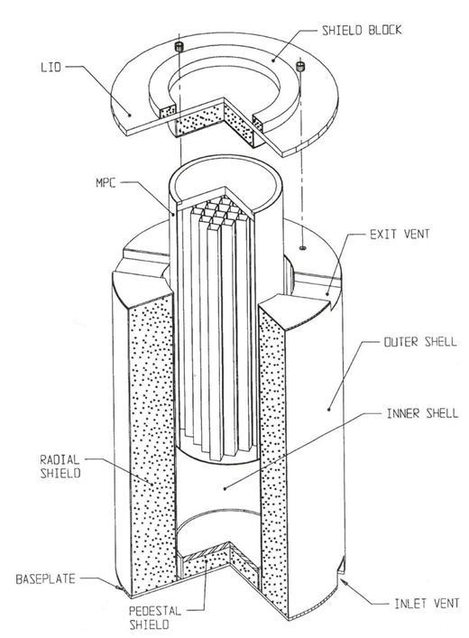
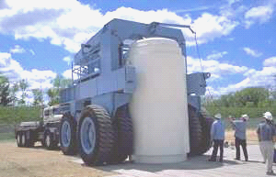
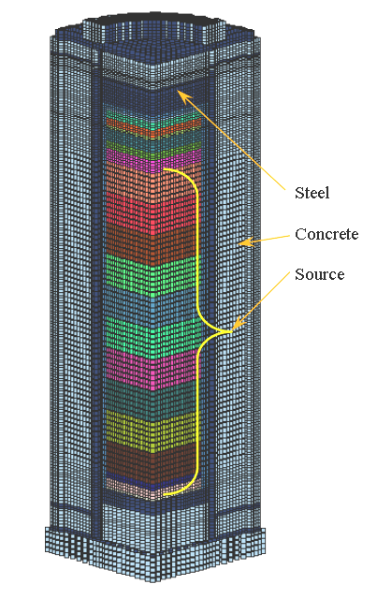
Memory Tuning Example:
Fuel Cask Model
PENTRAN 3-D model of fuel storage cask, 1/4 symmetry, 40 Group P3-S12, 318,426 cells : 2.14 Billion Eqns

Slide 25
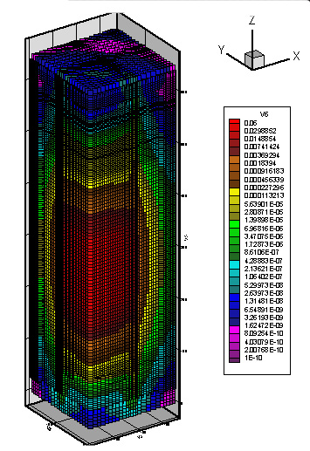
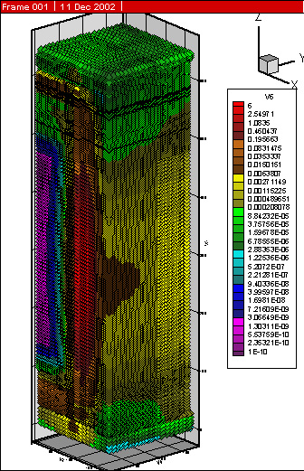
Cask 3-D Flux Distribution
Group 22
Group 1
By Shedlock & Haghighat

Slide 26
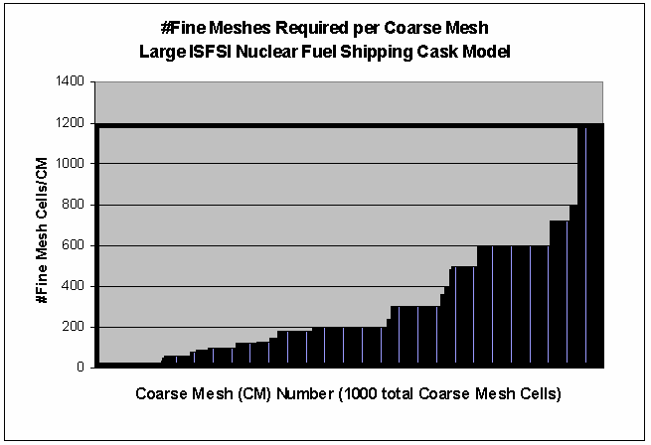
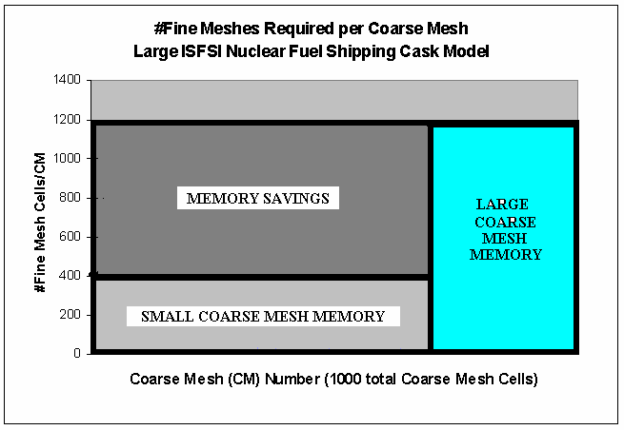
Two-Level Memory Tuning
Original ISFSI Cask Model global upper limit memory specification wasteful
Optimized Memory Tuning Cask Model with Two-Level memory specification

Slide 27
3-Level Adaptive Differencing
PENTRAN has 3 adaptive differencing levels
All schemes based on 0th spatial moment balance
Less parallel information to pass on a given mesh compared to higher order methods
Level 1: Diamond Zero (DZ)
Use DZ until a fixup is needed
Level 2: Directional Theta-Weighted (DTW)
Use until weight exceeds 0.95 (Petrovic and Haghighat)
Level 3: Exponential Directional-Iterative (EDI)
Intended for severe streaming (Sjoden; Sjoden and Haghighat)

Slide 28
Level 1: DZ
Diamond Zero (DZ) Differencing
Still main scheme in many production codes
Simple, fast, linear flux extrapolation
Good in source regions/slowly varying flux
Non-linear “zero fixup” when exiting flux < 0
Prone to unphysical solution oscillations
Very ill-conditioned for parallel processing

Slide 29
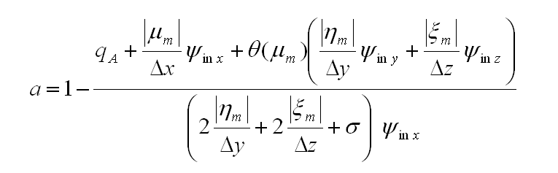
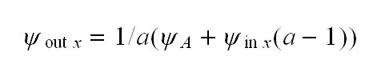
Level 2: DTW
Directional Theta Weighted Differencing
evolution from TW scheme (Rhoades & Engle) to a directional weighting by Petrovic and Haghighat
positive, with "proper” stable flux behavior
eliminates inherent oscillations
excellent in general, costs ~10%>DZ in 3-D
inaccurate with severe streaming, larger cells
equivalent to step scheme when cells are thick

Slide 30
Level 3: EDI
Exponential Directional Iterative Differencing
DTW predictor provides λ coefficient guess for auxiliary
Grew from EDW scheme
EDI formulation corrects average, outgoing flux
Still a 0th order based (spatial moment) scheme
Inherent positivity, accuracy in severe streaming
Cost: up to 2x DTW in 3-D, depending on λ coeff iterations

Slide 31
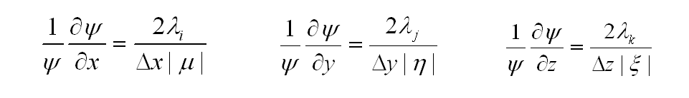
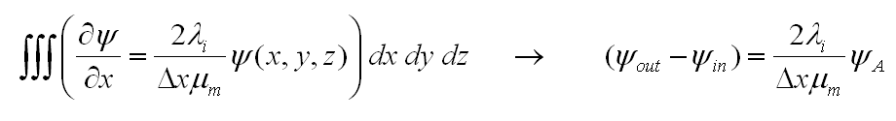
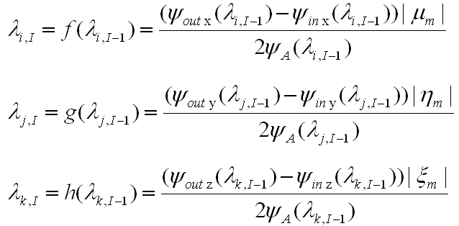
Level 3: EDI
Consider auxiliary partial derivatives
Applying the balance equation along x yields
Fixed point iteration formulations
Costs ~40%>DZ

Slide 32
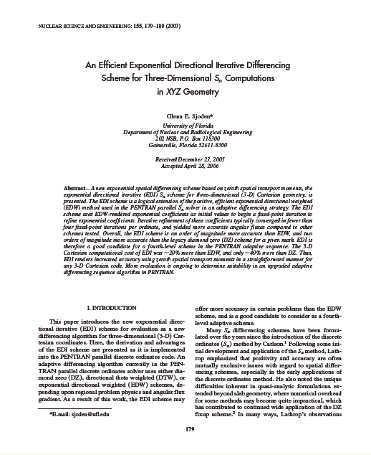
EDI: NSE Vol 155, pp. 179-189 (Feb 2007)
32

Slide 33
Non-Upgraded Schemes
Scheme 4: EDW Scheme
Similar to EDI scheme, but exponential arguments fixed at initial guess from DTW without iteration
Not typically as accurate as EDI, but can be a compromise between speed and accuracy when regions are known to require exponential treatment
Is not part of the 1-2-3 adaptive differencing sequence and must be selected by the user

Slide 34
Non-Upgraded Schemes
Scheme 5: CRT Scheme (Developed by Yi and Haghighat)
Characteristic Ray Trace (CRT) is a block-oriented transport solution method adapted for a coarse-mesh where the transport is solved along a characteristic ray projected across the coarse mesh coupled in flow to surrounding Sn meshes
Each set of characteristic rays are parallel to a direction of the angular quadrature from Sn.
Considers the whole coarse mesh as one region
The cross-section and angular source terms are constant throughout the region
CRT is not allowed for CMs containing fission or independent sources
Still main scheme in many production codes
Simple, fast, linear flux extrapolation
Good in source regions/slowly varying flux
Non-linear “zero fixup” when exiting flux < 0
Prone to unphysical solution oscillations
Very ill-conditioned for parallel processing

Slide 35
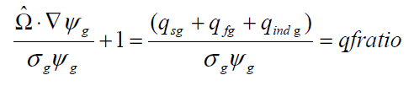
3-Level Adaptive Differencing: Selective Upgrade/Tuning Feature
Level 1 → Level 2 : DZ to DTW Upgrade
Use DZ until a fixup is needed
Level 2 → Level 3 : DTW to EDI Upgrade
Use until DTW weight exceeds 0.95 (weights close to 1 indicate ‘step’ differencing)
Strategy effective for no or low-level source
For strong sources, a test is performed with ‘qfratio’
If qfratio > 1.00 (default), DTW persists and we do not upgrade
No upgrade is performed if optical thickness of cells is less than 0.02 – for ‘vanishingly thin cells’ – stay with DTW

Slide 36
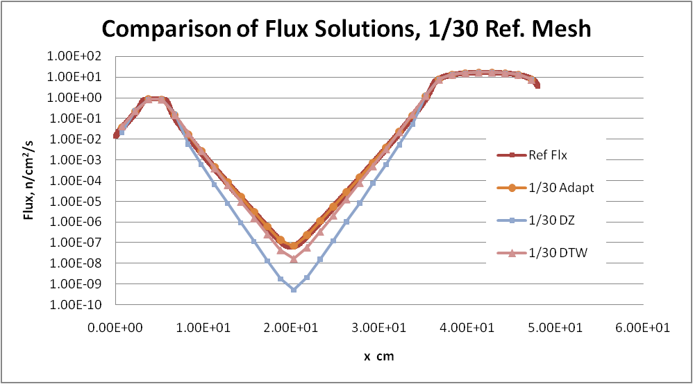
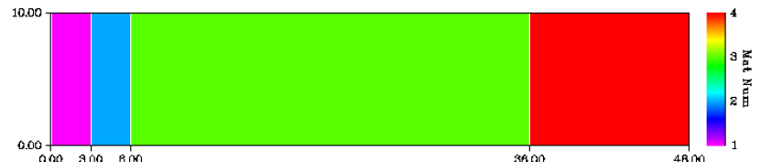
Numerical Testing: Simple Slab

Slide 37
Other Numerical Treatments
Uses a higher order mesh coupling scheme: Taylor Projection Mesh Coupling (TPMC)
Accelerations…
Two-grid 3-D TPMC-coupled “/” multi-grid transport acceleration
PCR with a zoned rebalance acceleration
Preconditioning with REPRO
Use a previous model to accelerate computation
Multigroup & One-level SI schemes

Slide 38
Taylor Projection Mesh Coupling
Coupling of Discontinuous grid densities
Allow high definition in ROIs, parallel load balance
First Order Taylor projection of angular fluxes at interface between discontinuous grid surfaces
Flow Step
Particle Balance Step
Important for “Coarse to Fine”

Slide 39
More Features
Allows for automatic Red-Black or Block-Jacobi, Automatic load balancing
Anisotropic scattering, arbitrary Pn moments
3-D angular quadratures
level symmetric through S₂₀, Legendre-Chebychev (Pn-Tn), arbitrary order
Vacuum, reflective, group-albedo boundaries
Volumetric sources, plane surface fluxes, currents
PENDATA, other utilities…

Slide 40
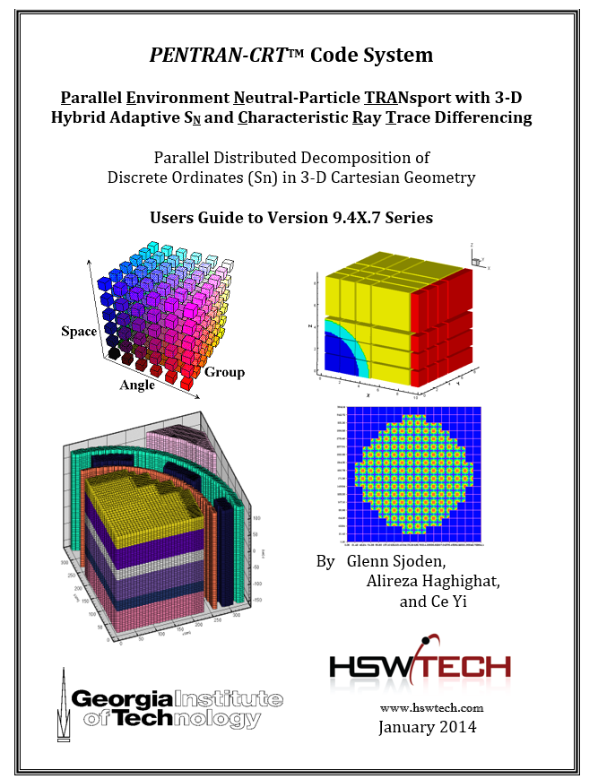
PENTRAN
Demonstrated >97% parallel fraction
Performance depends on problem, decomposition
Development focus on high accuracy & parallel efficiency
Numerous applications over the past 14 years
Speedups of 50-nx100 are achievable
Demonstrated scalability
http://www.hswtech.com/pdfs/PENTRANmanual.pdf

Slide 41
Simple Example: hello.f

Slide 42
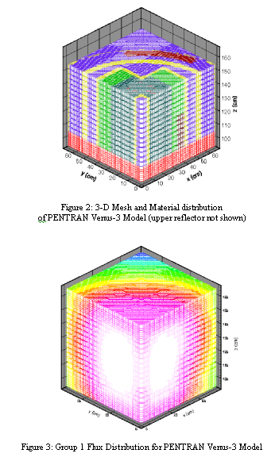
Venus-3 Model
PENMSH-XP code used to generate 3-D Cartesian Grid
~85,000 cells
26 Groups
P3-S8 Discrete Ordinates
Group 1 Flux Solution:

Slide 43
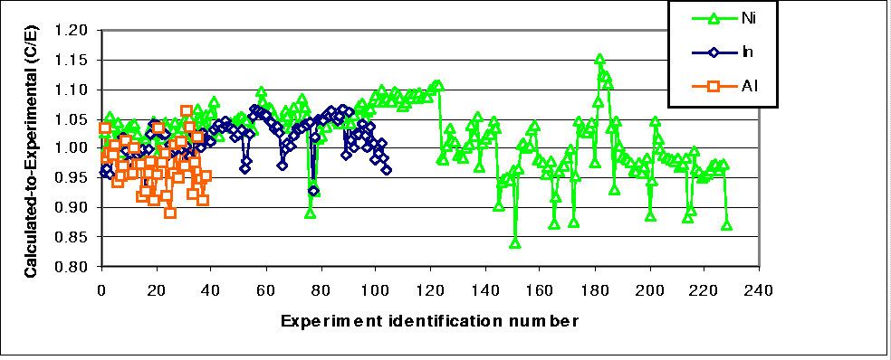
Venus-3 Results
Compared 370 Measured Rxn Rates (Ni, In, Al dosimeters)
vs Integral Rxn Rates computed from PENTRAN P3-S8 26 group-dependent fluxes.
95% C/E values +/-10%; 5% within +/-15% (near P/L rods).

Slide 44
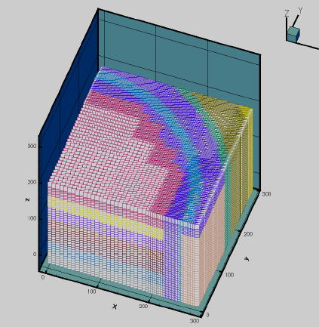
BWR Core Shroud Problem
BWR reactor and Core Shroud Assembly…
…with baffles, jet pumps, steam voids, etc.
(Top) 67 Group P3-S8 coupled neutron-gamma calculation
265,264 fine mesh cells
Solved in 12 hours on 48 IBM-SP2 processors… 8 processors angular, 6 processors spatial decomposition.

Slide 45
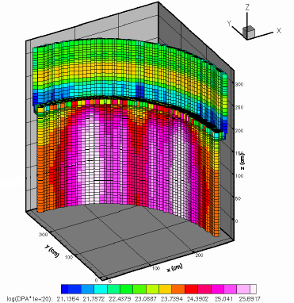
BWR Core Shroud Results
Displacement per Atom (DPA) in the core shroud shows intense radiation damage where fuel is close to the shroud.
Results were verified independently by Monte Carlo computations
Multigroup PENTRAN (using BUGLE-96) values were within 5-15% of continuous energy MCNP values.
(Kucukboyaci, et. al, 2000).

Slide 46
X-Ray Modeling ...
90 m³ room discretized into ~131,000 3-D cells
PENMSHTM code (8 “z-levels” floor to ceiling)
BUGLE-96: last 4-group photon xsecs
80kV radiographic W-anode 32 mAs x-ray burst
Rotating anode water cooled
Hybrid X-ray Spectrum
Characteristic X-rays
Bremsstrahlung continuum

Slide 47
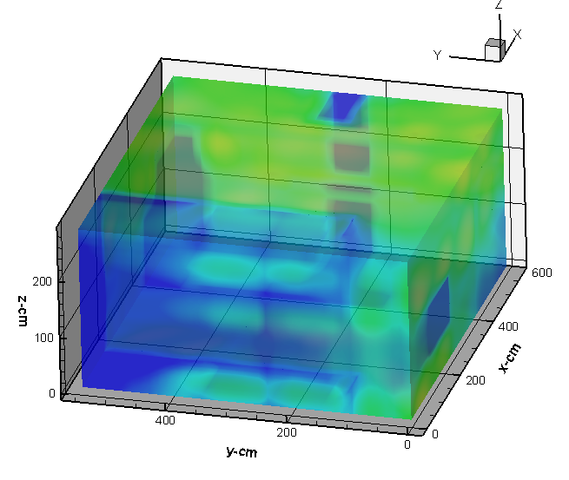
X-Ray Dose, z=100 cm

Slide 48
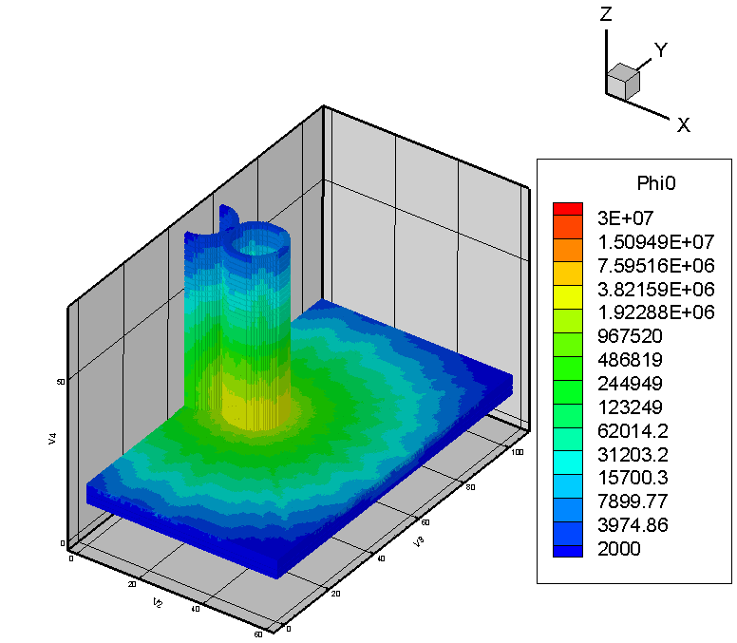
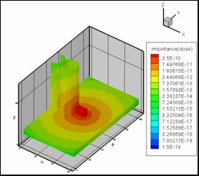
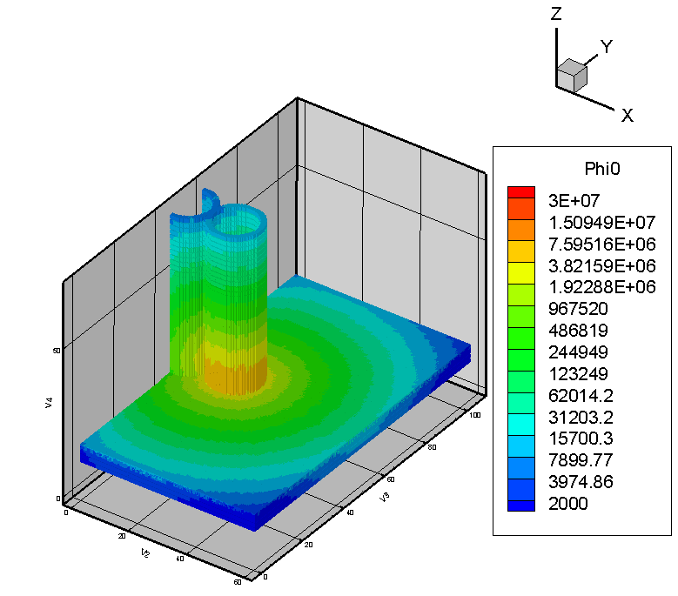
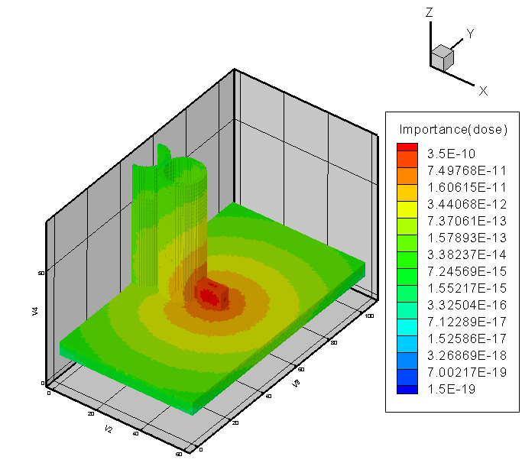
Gamma Transport Example
0.5 MeV 0.5 MeV
forward adjoint
(relative to
detector response)
0.15 MeV 0 0.15 MeV
forward adjoint

Slide 49
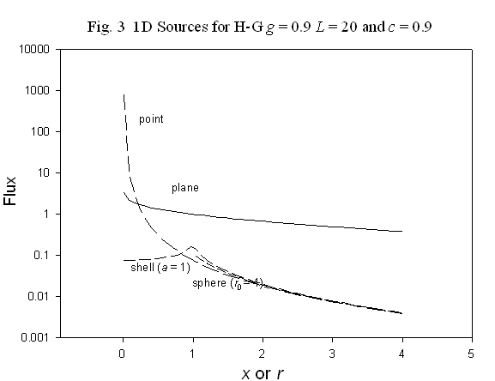
“TIEL” Benchmarks Tested the Numerics…
Proposed by Ganapol
Ganapol, JBC-M&C Division, 2006, Source Series I
Goal: provide a set of analytical benchmark problems, solutions
infinite media, Variety of sources
Plane, Sphere, Shell, Point…
Well documented and solved using quasi-analytic methods
Fourier Transform inversion
Henyey-Greenstein (H-G) scattering kernel σ_{l}=c g ^{l} , Up to L=24 Scattering Order
Advantages
Can be unequivocally used as standards of comparison
Enable direct assessment of the quality of solutions and methodologies

Slide 50
Planar Source Problem
Difficulties close in near source (also noted by Ganapol) , accuracy affected by extent of the boundary in the model ->
Scalar flux solution at x=0.01 mfp (close in) for the plane source:
Effect of the S_{N} order for c =0.9, g =0.9, L=12, ε=10-3
Up to S₆₄ (4224 directions/mesh)
x (mfp) | PENTRAN-S₃₄ | Ref[1] | Rel_diff (%)
0.01 | 3.05371 | 3.29089 | 7.20718
1.12 | 0.9458 | 0.94499 | -0.08529
2.23 | 0.62624 | 0.62603 | -0.03353
3.34 | 0.45239 | 0.45228 | -0.02454
4.45 | 0.33914 | 0.33908 | -0.01698
5.56 | 0.25937 | 0.25937 | -0.00001
6.67 | 0.20073 | 0.20081 | 0.03984
7.78 | 0.15651 | 0.15671 | 0.13081
8.89 | 0.12256 | 0.12295 | 0.31233
10.00 | 0.09618 | 0.09681 | 0.65125

Slide 51
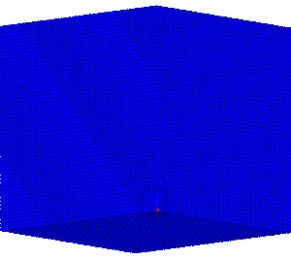
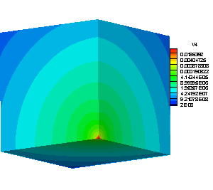
Point Source
The most challenging problem for a 3-D code
Isotropic source in a highly anisotropic medium
Modeled as a 12 x 12 x 12 mfp box divided in 86,000 fine cells of 5 mm (each side) cells, except for center region (0.5 mm)
First coarse mesh: Source (origin) as one single fine mesh cell of 0.5 mm size

Slide 52
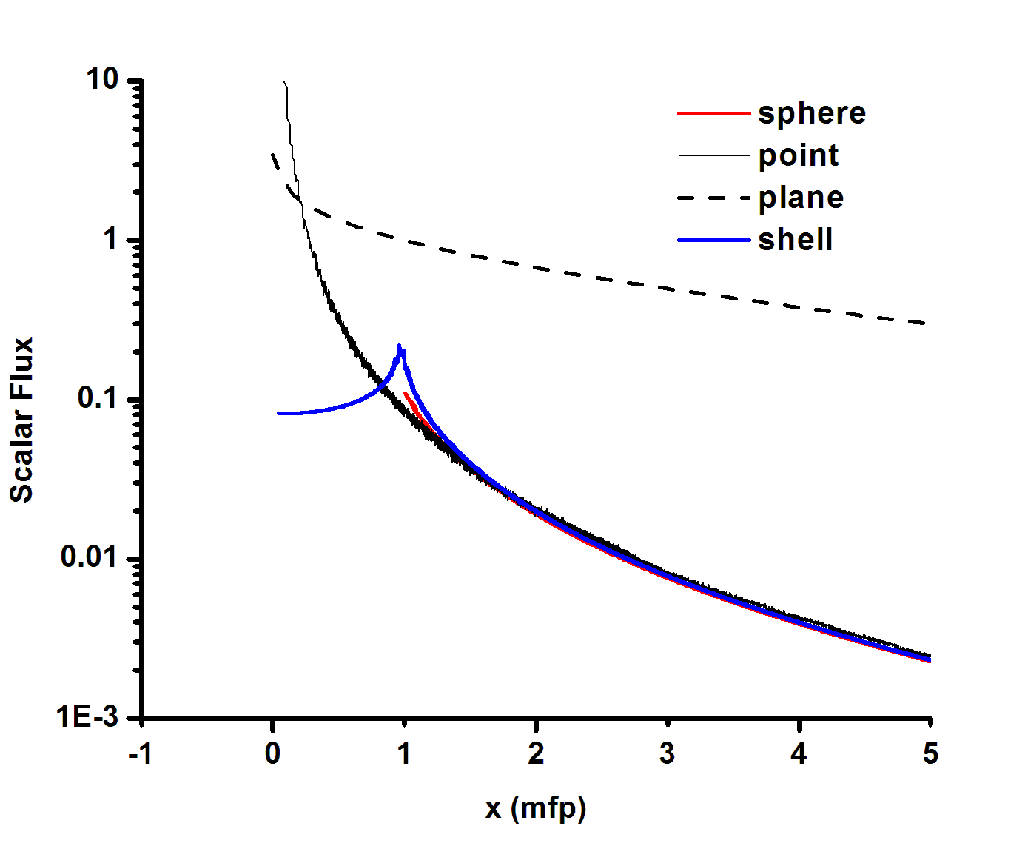
PENTRAN Solution Summary
Scalar flux solutions for the 1-D sources: c=0.9, g=0.9, L=12

Slide 53
TIEL Benchmark Findings
PENTRAN demonstrated Good Agreement with benchmarks
Solutions accurate to < 0.7% difference
Demonstrated accuracy and asymptotic convergence
Verified arbitrary S_{N} P_{L} formulations in code
3-D Legendre-Chebychev quadratures to N=64 (4224 dir) here
3-D Anisotropic scattering to L=24
Other Issues
EDI vs EDW differencing algorithms; EDI better adapts to various scattering situations
Verified Angular-Spatial Parallel numerics of PENTRAN
Importance of parallel computing to yield results in 3-D codes
Excellent learning exercise for students
Confidence in solutions as we develop other supporting tools & methods

Slide 54
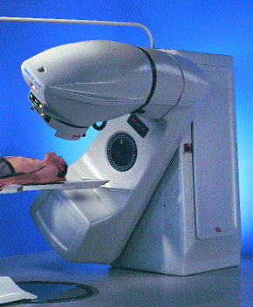
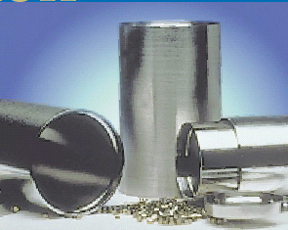
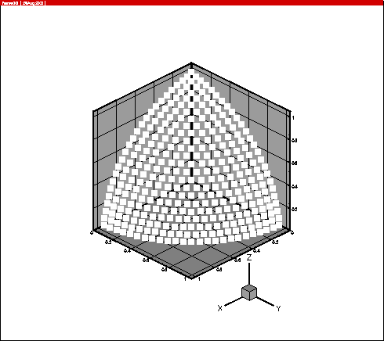
Simplified Co-60 Problem
Idealized model of a teletherapy device for benchmark applications
This model consisted of four key components:
source (2×2×2 cm3)
lead source housing 4 cm thick, air layer
homogeneous water phantom (30×30×30 cm3)
P3-S42 Discrete Ordinates (1848 directions/ mesh/energy group)

Slide 55
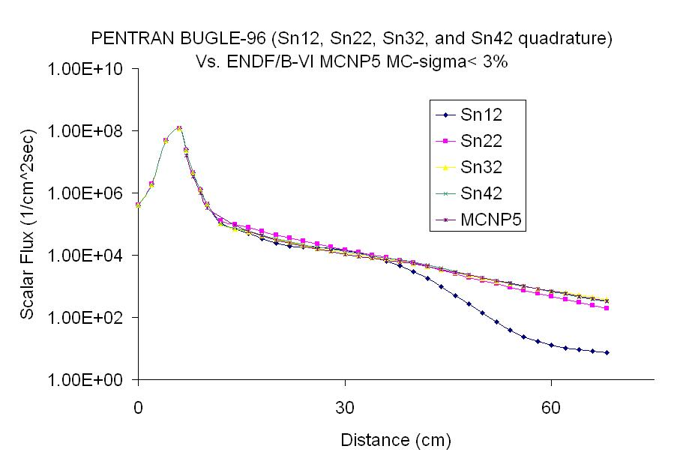
Investigation of Angular Quadrature

Slide 56
OSU Reactor Model

Slide 57




Co-60 Device 3-D scalar flux distributions slices model at different x-levels with S12
gamma-ray 3-D Group 1 scalar flux distribution for depth 0cm, 5cm, 10 cm and 15 cm, computed by PENTRAN with the BUGLE-96 gamma cross section library, (An S12 angular quadrature,168 directions, with P3 scattering anisotropy was used).

Slide 58




Co-60 Device 3-D scalar flux distributions slices model at different x-levels with S42
Gamma-ray 3-D Group 1 scalar flux distribution for x-level depths at 0cm, 5cm, 10 cm and 15 cm, computed by PENTRAN with the BUGLE-96 gamma cross section library; an S42 angular quadrature (1848 directions) with P3 scattering anisotropy as a reference case.

Slide 59



Significant efforts in
Shielding calculations…

Slide 60
Previous burnup studies

Slide 61





Westinghouse Assembly Model
Group 3
(E < 0.625 eV)

Slide 62
PENBURN with ‘BURNDRIVER’ methodology
“Forward-Euler” approach - fluxes solved at the beginning of each time step are assumed to be constant over step.
Considerations are currently being made to consider a mid-step depletion/transport calculation to forecast mid-step fluxes.
Infinite dilution cross-section treatment – microscopic cross sections are assumed to remain constant through burnup.
Dehart has shown this assumption begins to fail when in-growth reaches 1x10⁻³ atom/bn-cm.
Cross-section updates need to be considered when reaching this large of in-growth.

Slide 63
burndriver.sh
GMIX
Macro cross section mixer
Input
burnset.inp
PENTRAN
3-D Transport Solver
prbname.xsc
Remix cross-sections based on new isotopic concentrations
REPRO
Flux preconditioner
for (n+1)burn step
prbnames0.gmx
stepn
folder
prbname.grp
PENPOW
Reaction Rate Solver
prbname.f90
PENBURN
Fuel Depletion Solver
penburn.path
Output
prbnames(n+1).gmx
burnsum.out
GETDATA.sh
Finish all burn steps?
KEFF.sh
keff.out

Slide 64
PENTRAN Westinghouse Assembly Calculation
Full length, 17x17 PWR assembly (w/out control rod fingerlings) is currently modeled in PENTRAN.
Active length: 365.76 cm
Assembly pitch: 21.5 cm
Total PENTRAN meshes: 4.5 x 10⁶
Homogenized fuel pins (fuel/gap/clad).
Each fuel pin modeled as unique material
3*264 fuel materials + 1 water material = 793 total
Allows for pin-by-pin depletion in PENBURN

Slide 65



Group 1
(1 MeV < E < 20 MeV)
Group 3
(E < 0.625 eV)
Group 2 (0.625 eV<E<1 MeV)

Slide 66
SFCOMPO Database
SFCOMPO: Spent Fuel COMPosition Database
Found at http://www.nea.fr/sfcompo/
Database which archives isotopic compositions of spent fuel assemblies pulled from power reactors.
Determined from gamma spectrometry and chemical analysis.
Originally developed by the JAERI Department of Fuel Cycle Safety Research's Fuel Cycle Safety Evaluation Laboratory and later transferred to the NEA.

Slide 67
SFCOMPO (cont’d)
Contains data for PWR and BWRs from Germany, Italy, and Japan.
Provides operation history for fuel element, and even shows position in core at each irradiation step.
Website includes search engine which allow the user to search based on a reactor name or range of burnup, initial enrichment, and cooling time after irradiation.
Good alternative to comparisons with SCALE simulations.

Slide 68

Investigation of Mesh Interval
Mesh variations in the Co-60 model

Slide 69
BURNDRIVER
PENBURN sequence is now automated with the release of BURNDRIVER shell script.
Script creates all necessary directories, moves inputs/outputs, executes programs, and creates output summary files.
Requires 6 input files:
1. burnset.inp 2. prbname.gmx
3. penburn.path 4. prbname.xsc
5. prbname.f90 6. prbname.grp
SCALE5.1
T-NEWT
Micro cross-section generator
DEV-XS
GMIXFORM and COLLAPSEFORM
PENMSHXP
PENTRAN geometry/input generator
SCALFORM
prbnames0.gmx
prbname.f90
prbname.grp
prbname.xsc
penburn.path
burnset.inp
Sources of input files.

Slide 70
burnset.inp
/ problem name
whpin
/ # of processors for parallel PENTRAN run
8
/ Following 3 lines dedicated to PENPOW Problem Description
Westinghouse Hetr Pin Burnup Study
17 x 17 OFA Assembly
Fuel Gap Clad Moderator Regions
/ number of fuel materials, no. nonburn nuclides
1
/ range of fuel material number: eg. 1 10
1 1
.
.
.

Slide 71
burnset.inp
/ Following 3 lines dedicated to PENBURN Problem Description
Westinghouse Hetr Pin Burnup Study
17 x 17 OFA Assembly
Fuel Gap Clad Moderator Regions
/ # of irradiation/cool steps
2
/ power, time, time unit (d), irrad (i)/cool(c), print step, print option, GMIX keyword
-30 1 d i 1 2 s1
-30 3 d i 1 2 s2
*Very familiar to penburn.inp

Slide 72
INTERP-XS
Purpose: Creates a problem dependent microscopic cross-section file based on specified:
Avg. system energy (MeV)
Operating temperature (K)
Burnup (GWd/MTU)
Microscopic cross-section libraries generated for three reactor systems:
Thermal: PWR WH fuel pin
Epithermal: Graphite moderated Magnox fuel pin
Loosely based off of UFCD II design
Fast: Clinch River Breeder Reactor fuel pin
Hexagonal lattice, Na cooled
NOTE: Spectra characterized by MCNP analysis of unit cell’s neutron density distribution.

Slide 73
INTERP-XS (cont’d)
System temperatures: 300, 650, 1000, 1350 K
Libraries currently exist for fresh fuel concentrations
Libraries for mid-cycle fuel compositions are work in progress.
2 types of interpolation methods:
Linear interpolation
Option for using lethargy, ln(Eo/E), instead of energy, E
Aitken’s Method: work in progress

